Slide 1
Lecture 8: Graph Algorithms (II)
Dr. Tsung-Wei Huang
Department of Electrical and Computer Engineering
University of Utah, Salt Lake City, UT

Slide 2
Graph Traversal
Depth First Search (DFS)
Stack
The algorithm starts at the root node (selecting some arbitrary node as the root node in the case of a graph) and explores as far as possible along each branch before backtracking.
Breadth First Search (BFS)
Queue
The algorithm starts at the root node, and explores all of the neighbor nodes at the present depth prior to moving on to the nodes at the next depth level.

Slide 3
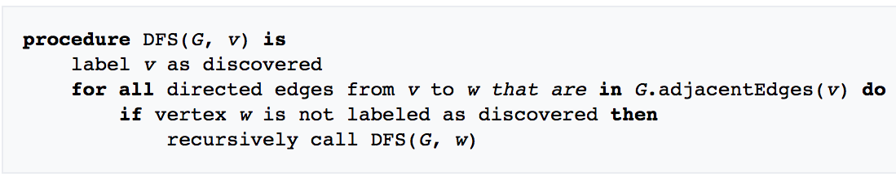
DFS Algorithm

Slide 4
BFS Algorithm
Start
Insert the starting node(s) to the queue
yes
empty？
no
Pop a node u from the queue
Insert all neighboring nodes of u to the queue
stop

Slide 5
Cut Vertex (Articulation Point)
Formal definition
A cut vertex or articulation point is a vertex in a graph such that removal of the vertex causes an increase in the number of connected components.
If the graph was connected before the removal of the vertex, it will be disconnected afterwards.
A
B
A
B
C
C is a cut vertex
D
D
E
E
Notes:
Now, we can use dfs or bfs to explore some important properties of a graph.

Slide 6
How to Find Cut Vertices?
Brute force?
Enumerate all vertices O(N)
Remove the vertex from the graph
Perform union-and-find algorithms to find the number of sets
If the number of disjoint sets increases, the vertex is a cut
Total time complexity is O(N²logN)
Each union-and-find takes O(NlogN), needs N times
A
B
A
B
Remove C; set count increases from 1 to 3
C
D
D
E
E

Slide 7
DFS can Do This for us More Efficiently
We have two edge types during DFS
Forward edge u→v, v is not visited
Backward edge u→v, v is visited (except parent)
0
8
9
1
7
2
3
5
4
6
Let’s start from 3
Notes:
DFS can do this for us more efficiently. During the traversal, we start from a vertex u to explore. We have two edge types:

Slide 8
DFS can Do this for us
We have two edge type during DFS
Forward edge u→v, v is not visited
Backward edge u→v, v is visited
5
9
10
0
8
9
0
8
9
4
1
7
1
7
8
3
1
6
2
3
5
2
3
5
4
6
7
4
6
Let’s start from 3
2
Lebel the order of traversal in a linear array “dfn”
Notes:
I can label each number with a number indicating the times it got visited.

Slide 9
DFS can Do this for us
We have two edge type during DFS
Forward edge u→v, v is not visited
Backward edge u→v, v is visited
1
3
2
6
4
5
5
9
10
0
8
9
0
8
9
3
7
4
2
6
1
7
1
7
8
3
1
6
4
8
2
3
5
2
3
5
1
7
4
6
7
4
6
10
5
9
Let’s start from 3
2
0
8
9
Lebel the order of traversal in a linear array “dfn”
DFS gives us a spanning tree order of vertices

Slide 10
Cut Vertex Property
Observation
If root has two children, => the root is a cut vertex
If a vertex u has a child v such that v can’t go back to u’s parent => u is a cut vertex
Assume no duplicate edges between vertices
Let’s quantify this
low[u]: the minimum dfn value u can reach
min{ low[u], low[v] }, foreach edge u→v

Slide 11
Example of dfn[i] and low[i]
dfn/low
5
9
10
1/1
0
8
9
3
2/1
6/6
4
4
5
1
7
8
3/1
7/6
3
1
6
2
6
2
3
5
4/1
8/6
1
7
7
4
6
5/5
9/9
10/10
2
0
8
9

Slide 12
Cut Vertices Identified
dfn/low
5
9
10
1/1
0
8
9
3
2/1
6/6
4
4
5
1
7
8
3/1
7/6
3
1
6
2
6
2
3
5
4/1
8/6
1
7
7
4
6
5/5
9/9
10/10
2
0
8
9

Slide 13
Algorithm
void dfs(int u) {
visited[u]=true;
low[u]=dfn[u]=__________;
int child=0;
for(int i=0; i<adj[u].size(); i++) {
int v=adj[u][i];
if(visited[v]==false) {
child++;
parent[v]=u;
dfs(v);
low[u]=__________;
if_________________________________________________________________
cut[u]=true;
}
else if(v!=parent[u]) { // backward edge
__________________
}
}
Initialization:
times=0, parent[i]=-1, cut[i]=0, visited[i]=0
Notes:
Blank 0: low[u]=min(low[u], low[v]);
Blank 1: low[u]=dfn[u]=(++times);
Blank 2: if( ((parent[u]!=-1) and ( low[v]>=dfn[u] )) or ( (parent[u]==-1) and (child>1)))
Blank 3: low[u]=min(low[u], dfn[v]);

Slide 14
Cut Edge
Observation
For each edge u→v, if __________ => cut edge
dfn/low
5
9
10
1/1
0
8
9
3
2/1
6/6
4
4
5
1
7
8
3/1
7/6
3
1
6
2
6
2
3
5
4/1
8/6
1
7
7
4
6
5/5
9/9
10/10
2
0
8
9
Notes:
low[v] > dfn[u]

Slide 15
Cut Edge
We have four cut edges in this example
0-1, 3-5, 8-7, 7-9
dfn/low
5
9
10
1/1
0
8
9
3
2/1
6/6
4
4
5
1
7
8
3/1
7/6
3
1
6
2
6
2
3
5
4/1
8/6
1
7
7
4
6
5/5
9/9
10/10
2
0
8
9

Slide 16
Bi-connected Components
A connected graph with NO cut vertices
Find all biconnected subgraphs in a graph
0
8
9
0
8
9
1
7
7
1
7
1
3
5
7
2
3
5
2
3
5
4
6
4
6
six bi-connected components

Slide 17
Let’s Use a Simple Example first …
Apparently, we have two bi-connected components
Cut vertices exist in the boundary between components
otherwise, it’s not connected by contradiction
1
1
3
5
2
3
5
2
3
4
4
two bi-connected components

Slide 18
Algorithms
Maintain a stack of traversed edges so far
This records the “trace” of our traversal
Edges between decision boundary form a component
When we find a cut vertex
Pop all edges from the stack until the decision boundary
1
2
3
5
4
Decision boundary on cut vertex

Slide 19
Example
dfn/low
1
1/1
2
3
5
-1→3
4

Slide 20
Example
dfn/low
2/2
1
1/1
2
3
5
-1→3 | 3→1
4

Slide 21
Example
dfn/low
2/2
1
1/1
3/3
2
3
5
-1→3 | 3→1 | 1→2
4

Slide 22
Example
dfn/low
2/2
1
1/1
2
3
5
-1→3 | 3→1 | 1→2 | 2→4
3/3
4
4/4

Slide 23
Example
dfn/low
2/2
1
1/1
2
3
5
-1→3 | 3→1 | 1→2 | 2→4 | 4→3
3/3
4
4/1

Slide 24
Example
dfn/low
2/2
1
1/1
2
3
5
-1→3 | 3→1 | 1→2 | 2→4 | 4→3
3/1
4
4/1

Slide 25
Example
dfn/low
2/1
1
1/1
2
3
5
-1→3 | 3→1 | 1→2 | 2→4 | 4→3
3/1
Decision boundary on cut vertex 3
4
4/1

Slide 26
Example
dfn/low
2/1
1
1/1
2
3
5
-1→3 | 3→1 | 1→2 | 2→4 | 4→3
3/1
Pop out all edges until 3→1 to form a bi-connected component
4
1
4/1
2
3
4

Slide 27
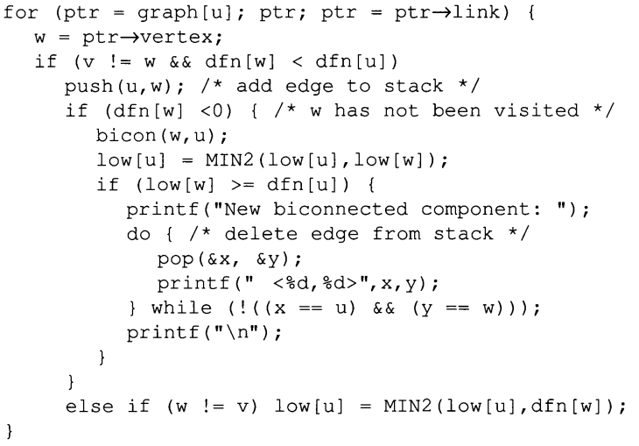
Implementation Details
v
Cut vertex found!
u
w
Backward edge

Slide 28
Shortest Path Algorithms
Single source all destinations
Given a weighted directed graph G, find the minimum-weight path from a given source vertex s to all other vertices
“Shortest-path” = minimum summation weight
Weight of path is sum of edges
Tremendous applications
Map: what is the shortest path from SLC to CA?
Circuit design: what is the minimum interconnect?
What is the shortest path from a to z?
Notes:
The next topic we are going to talk about is shortest path algorithm. This is probably one of the most important subjects in computer science, especially when you want to solve graph problems.

Slide 29
Shortest Paths may Not Exist
If graph contains non-reachable targets
If graph contains negative cycles
Negative cycle
No route from vertex 0 to vertex 4

Slide 30
Shortest Path Property
Optimal substructure
The shortest path consists of shortest subpaths
Easy to prove by contradiction
Let δ(u,v) be the the shortest path from u to v:
Shortest paths satisfy the triangle inequality
δ(u,v) ≤ δ(u,x) + δ(x,v)

Slide 31
Algorithm
Key technique: relaxation
Maintain upper bound d[v] on δ(s,v):
Relax(u,v,w) {
if (d[v] > d[u]+w) then d[v]=d[u]+w;
}
5
2
9
5
2
6
Relax
Relax
5
2
7
5
2
6

Slide 32
Bellman Ford
BellmanFord()
for each v ∈ V
d[v] = ∞;
d[s] = 0;
for i=1 to |V|-1
for each edge (u,v) ∈ E
Relax(u,v, w(u,v));
Relax(u,v,w): if (d[v] > d[u]+w) then d[v]=d[u]+w
Initialize d[], which
will converge to shortest-path value δ
Relaxation: Make |V|-1 passes,
relax each edge
The simplest shortest path algorithm

Slide 33
Bellman Ford
π: nil
d: 0
π: nil
d: ∞
A
2
B
-1
π: nil
d: ∞
2
3
C
-3
4
5
3
-1
D
E
4
π: nil
d: ∞
π: nil
d: ∞

Slide 34
Bellman Ford
π: nil
d: 0
π: nil A
d: ∞ -1
A
2
B
-1
π: nil C
d: ∞ 2
2
3
C
-3
4
5
3
-1
D
E
4
π: nil A
d: ∞ 4
π: nil
d: ∞

Slide 35
Bellman Ford
π: nil
d: 0
π: nil A
d: ∞ -1
A
2
B
-1
π: nil C
d: ∞ 2
2
3
C
-3
4
5
3
-1
D
E
4
π: nil A
d: ∞ 4
π: nil C
d: ∞ 3

Slide 36
Complexity
Running time: O(VE)
Not so good for large dense graphs
But a very practical algorithm in many ways
What about graph with negative cycles …?

Slide 37
Bellman Ford
π: nil
d: 0
π: nil
d: ∞
A
2
B
-1
π: nil
d: ∞
2
1
C
-3
4
5
1
-1
D
E
4
π: nil
d: ∞
π: nil
d: ∞

Slide 38
Bellman Ford
π: nil
d: 0
π: nil A
d: ∞ -1
A
2
B
-1
π: nil C
d: ∞ 2
2
1
C
-3
4
5
1
-1
D
E
4
π: nil A
d: ∞ 4
π: nil
d: ∞

Slide 39
Bellman Ford
π: nil
d: 0
π: nil A
d: ∞ -1
A
2
B
-1
π: nil C B
d: ∞ 2 0
2
1
C
-3
4
5
1
-1
D
E
4
π: nil A
d: ∞ 4
π: nil
d: ∞

Slide 40
Bellman Ford
π: nil
d: 0
π: nil A
d: ∞ -1
A
2
B
-1
π: nil C B
d: ∞ 2 0
2
1
C
-3
4
5
1
-1
D
E
4
π: nil A
d: ∞ 4
π: nil C
d: ∞ 1

Slide 41
Bellman Ford
π: nil
d: 0
π: nil A E
d: ∞ -1 -2
A
2
B
-1
π: nil C B B
d: ∞ 2 0 -1
2
1
C
-3
4
5
1
-1
D
E
4
π: nil A
d: ∞ 4
π: nil C
d: ∞ 1

Slide 42
Bellman Ford
BellmanFord()
for each v ∈ V
d[v] = ∞;
d[s] = 0;
for i=1 to |V|-1
for each edge (u,v) ∈ E
Relax(u,v, w(u,v));
for each edge (u,v) ∈ E
if (d[v] > d[u] + w(u,v))
return “no solution”;
Relax(u,v,w): if (d[v] > d[u]+w) then d[v]=d[u]+w
Initialize d[], which
will converge to shortest-path value δ
Relaxation: Make |V|-1 passes,
relax each edge
Test for solution:
have we converged yet?
ie, ∃ negative cycle?

Slide 43
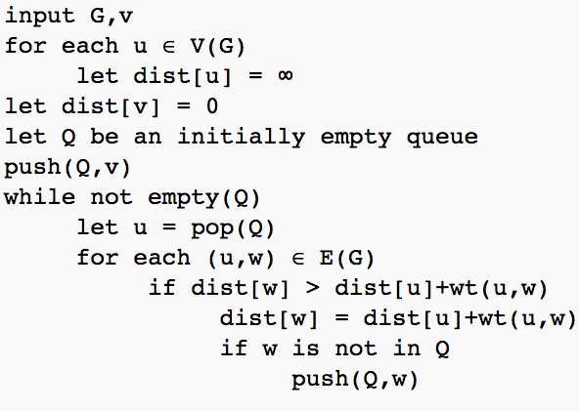
Bellman-Ford Variant: SPFA
Shortest path faster algorithm (SPFA)
Modified Bellman-Ford using either BFS pattern
Maintain the “frontier” vertices to relax
Practical performance is excellent

Slide 44
Example
Let’s start from v0

Slide 45
Example
Insert v0 into the queue

Slide 46
Example
Relax v1 and v4 and insert them to the queue

Slide 47
Example
Relax v2 and v4 and insert them to the queue

Slide 48
Example
Nothing to relax from v4

Slide 49
Example
Relax v3 and insert it to the queue

Slide 50
Example
Nothing to relax from v3, done

Slide 51
SPFA Properties
If a vertex is inserted into the queue N times
Negative cycle found!
What is the time complexity of SPFA?

